Slide 1
Workshop 1: Game Based Learning (GBL) and unplugged activities
Session 5: Designing learning scenarios using graphical tool

Slide 2
Authors and licence
Authors:
Mart Laapere, Tallinn University, Centre for Educational Technology martl@tlu.ee
James Sunney Quaicoe, Tallinn University, School of Digital Technologies paasanni@tlu.ee
Kai Pata, Tallinn University, School of Digital Technologies kpata@tlu.ee
This work is licensed under a Creative Commons Attribution-ShareAlike 4.0 International License.
Attribution should be given in the following way: GLAT project, https://ec.europa.eu/programmes/erasmus-plus/projects/eplus-project-details/#project/2017-1-HR01-KA201-035362

Slide 3
Agenda
Short review of previous knowledge
Introduction to LePlanner
lesson design
exploring the features of LePlanner
signing up for an account

Slide 4
Short review of previous knowledge
What is your opinion on the following themes of the workshop:
games in learning
designing learning scenarios
incorporating games-based learning in your learning scenarios
What new professional impressions or knowledge have you internalize so far?

Slide 5
Introduction to LePlanner

Slide 6
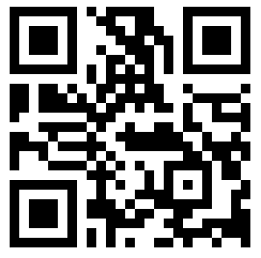
LePlanner
Tool for designing, visualization and sharing learning scenarios
Developed at School of Digital Technologies, Tallinn University
Available online: https://beta.leplanner.net
Learning scenario designing environment LePlanner.net
https://vimeo.com/168032150

Slide 7
Features of LePlanner
Main Features:
details
timeline
publish
Details: title, description, tags, subject, learning outcomes, grade, duration and activities
Timeline: in-class activity and off-class activity, student resources
Publish: draft and language
Support systems: medium for addressing students’ concerns, remedial actions, etc.

Slide 8
Lesson design - Teacher resources
Objectives
Teacher activities
Supporting teaching resources
Technology
Instructional process and methodology (in-school, off-school)
Assessments

Slide 9
Lesson design - Student resources
Expected learning outcomes/competence
Student activities
Support learning resources
Technology
Level of interaction/Collaborations medium
Feedback channels

Slide 10
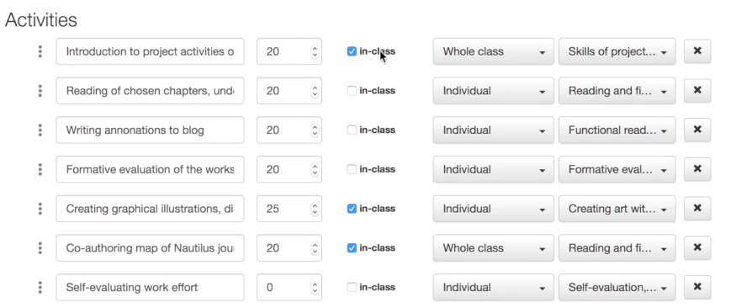
LePlanner: Defining activities

Slide 11
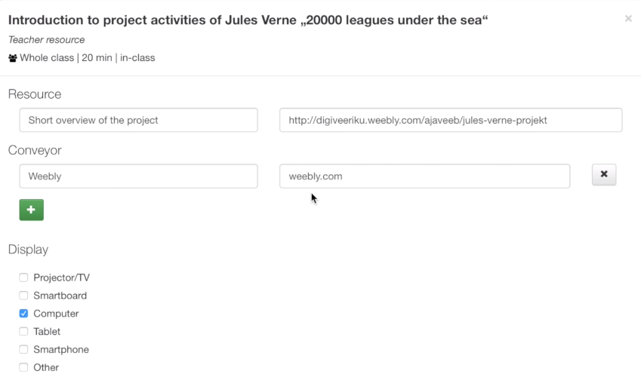
LePlanner: Defining resources

Slide 12
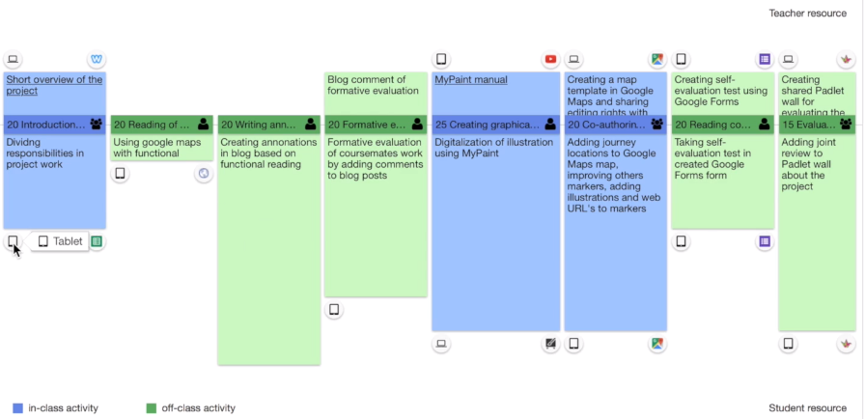
LePlanner: Timeline view (scenario)
resources and comments
for teachers
resources and comments
for students

Slide 13
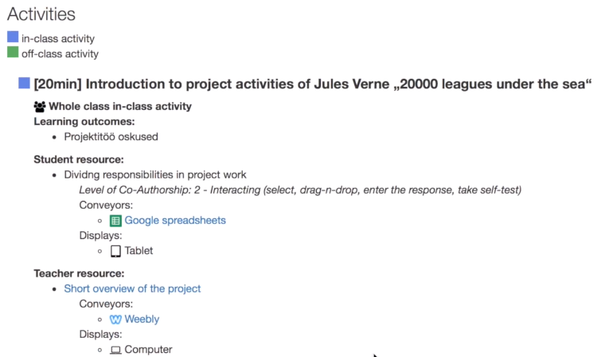
LePlanner: Text view (scenario)

Slide 14
Exploring LePlanner
Individual activity

Slide 15
Exploring LePlanner
Explore existing lesson scenarios developed using LePlanner.
Create user account.
Create a lesson scenario with several in-class and off-class activities.

Slide 16
Designing and implementing a learning scenario
Group activity

Slide 17
Designing an unplugged game-based learning scenario
Design a micro-teaching activity in groups of 5 members:
Select group name and subject of interest
Design unplugged game-based learning scenario to last for about 10-15 minutes on the LePlanner
Present created learning scenario to other groups
Review learning scenarios created by other groups
LePlanner Instructional Sheet
Notes:
The document with worksheet template (GLAT_WS1_S5_LePlanner_Instructional_sheet_EN.docx) should be in the same folder as this presentation.

Slide 18
Questions

