Slide 1
Workshop 1: Game Based Learning (GBL) and unplugged activities
Session 1: Game Based Learning (GBL)
Integration of games into the lecturing process

Slide 2
Authors and licence
Authors:
Vladimir Trajkovik, Ss. Cyril and Methodius University in Skopje, Faculty of Computer Science and Engineering trvlado@finki.ukim.mk
Ana Madevska Bogdanova, Ss. Cyril and Methodius University in Skopje, Faculty of Computer Science and Engineering ana.madevska.bogdanova@finki.ukim.mk
This work is licensed under a Creative Commons Attribution-ShareAlike 4.0 International License.
Attribution should be given in the following way: GLAT project, https://ec.europa.eu/programmes/erasmus-plus/projects/eplus-project-details/#project/2017-1-HR01-KA201-035362

Slide 3
Agenda
Factors for successful integration of games into the lecturing process
Games in the classroom
choice from the Macedonian teachers

Slide 4
Factors for successful integration of games into the lecturing process

Slide 5
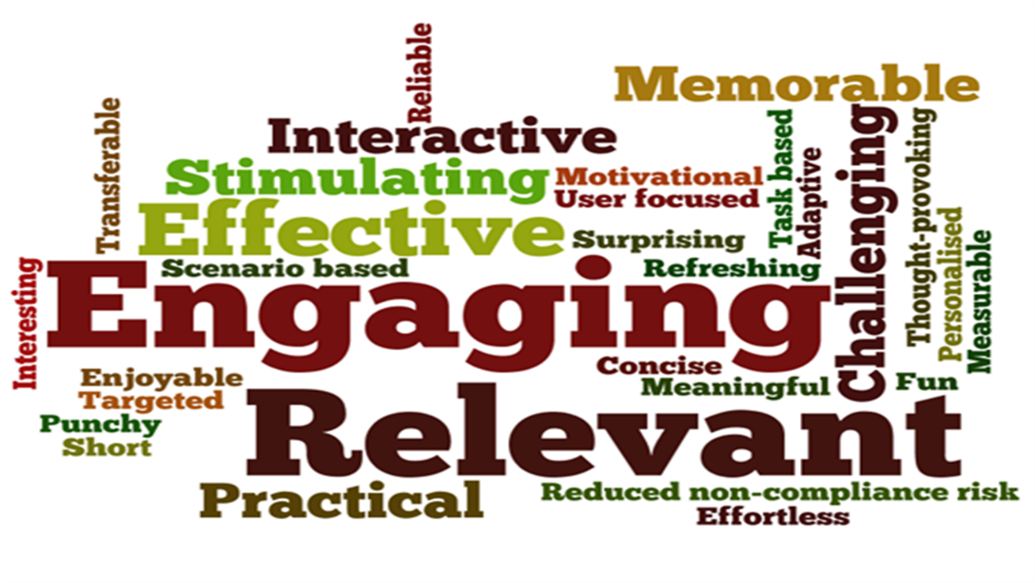
Successful integration of games into the lecturing process
Need for digital competences
various areas of development
Selection of proper game
educational value
quality of learning
game is fun

Slide 6
Digital competences for teachers
Digital Competence Framework for Educators: https://ec.europa.eu/jrc/en/digcompedu
self-evaluation tool
Focus on 6 areas of development:
usage of digital tools for professional development
recognition of different digital tools that can be applied
application digital tools in education
application of digital tools for assessment
application of digital tools for student support
development of students’ digital competences

Slide 7
Levels of digital competences
Every digital competence has different levels
The levels of competence are needed to:
understand
access
use
integrate into the teaching/learning
access the usage
create using tool
adapt to your needs

Slide 8
How to select a proper educational game?
What are the technical (pre)requirements for the game?
hardware requirements
Internet
software requirements
Is the game suitable for students’ age?
Do I (as an educator) have needed digital competences to use the game in the proper way?
Is it fun?
Whatever you think, ask your students!!!

Slide 9
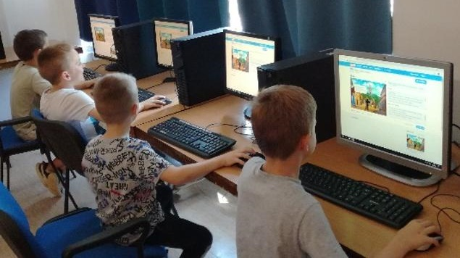
How do you know whether the game is fun for the students?
Is there any way to progress in the game (levels)?
Is it competitive (can you compare results)?
Is there any award?
Is it easy to understand?
Is it cooperative?
Can you play it outside the classroom?
...

Slide 10
When does the game have educational value? (1/2)
Can you relate game levels with educational goals?
Are there any game elements that are opposite to educational goals?
e.g. violence
Can the game be used for more than one educational goal in more than one subject (or other lecture in the same subject)?
Does the game enable “deep learning”?
Do the students need to solve non-routine problems while playing the game?

Slide 11
When does the game have educational value? (2/2)
Is Problem-Solving incorporated in the game design?
fact gathering, their evaluation, usage and creating some actions (or feedback)
reflex based
possible to repeat the actions and improve results
Is Critical Thinking incorporated in the game design?
players need to solve some puzzles
decision making
need to understand different perspectives (e.g. other players goals and strategies)
...

Slide 12
Is the game useful?
The quality of learning depends on:
Quality of experience while playing the game
Technology-related (objective, quantitative)
Fun-related (subjective, qualitative)
Quality of achieved knowledge
short-term, fact-based (e.g. is it suitable for multiple-choice questions based assessment?)
long-term, expandable (e.g. can be used within the projects in other lectures and/or subjects?)

Slide 13
Analysing examples
Group activity

Slide 14
1. General

Slide 15
Example 1.1. Science for kids
Fun science games for kids while learning more about science and technology
Free online activities to try with something for everyone
chemistry
biology
physics
...
http://www.sciencekids.co.nz/gamesactivities.html

Slide 16
Example 1.2. IXL
Immersive, adaptive learning
Math, language, arts, science
K12 education
10 Free practice problems
https://www.ixl.com

Slide 17
2. English

Slide 18
Example 2.1. Teach your monster to read
Free game that makes learning to read fun
Letters, sounds, reading full sentences
Designed in collaboration with leading academics
Complements learning programmes used in schools
https://www.teachyourmonstertoread.com

Slide 19
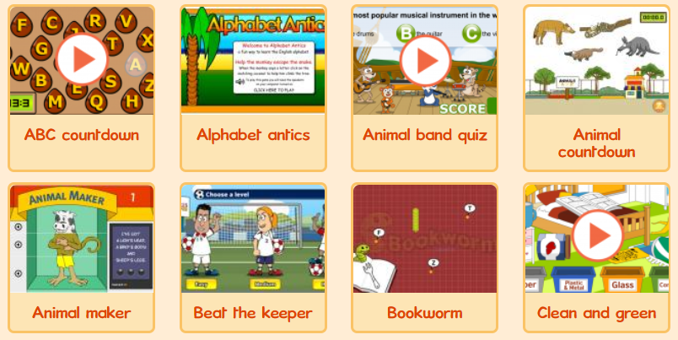
Example 2.2. Learn English, kids
Fun games in English:
listen and watch
read and write
speak and spell
fun and games
https://learnenglishkids.britishcouncil.org/en/games

Slide 20
3. Mathematics

Slide 21
Example 3.1. Mathplayground
Problem-solving math games:
logic and number puzzles
fraction adventures
thinking blocks
math word problem practice
money games
https://www.mathplayground.com/games.html

Slide 22
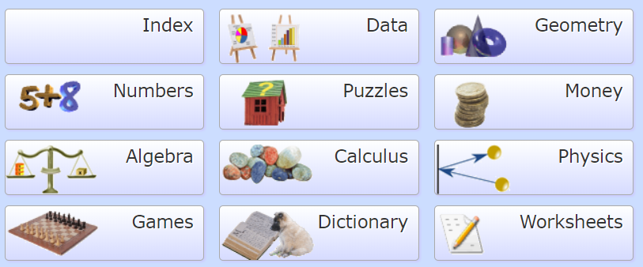
Example 3.2. Mathsisfun
Math explained in easy language:
algebra
data
geometry
measure
numbers
Dictionary
Games
Puzzles
Worksheets
https://www.mathsisfun.com

Slide 23
Example 3.3. Transum
Free math activities for teaching and learning:
puzzles and problems
visual aids, investigations
http://www.transum.org

Slide 24
Example 3.4. Fractions
Fractions games:
equivalent fractions game
add fractions
converting fractions into decimals
fraction word problem games
subtracting mixed fraction
…
http://www.fractions4kids.com

Slide 25
4. Geography

Slide 26
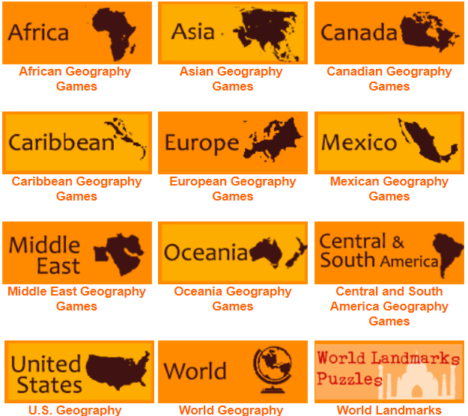
Example 4. Travel the world
Tutorials and games:
world's continents
countries
capitals
landscapes
Games for beginners, intermediate and advanced learners
http://www.sheppardsoftware.com/Geography.htm

Slide 27
5. Creative thinking

Slide 28
Example 5.1. Minecraft
Building in a 3D procedurally-generated world with a variety of different cubes
Requiring creativity from players
Other activities:
exploration
resource gathering
crafting
combat
Cost: 23$
https://minecraft.net

Slide 29
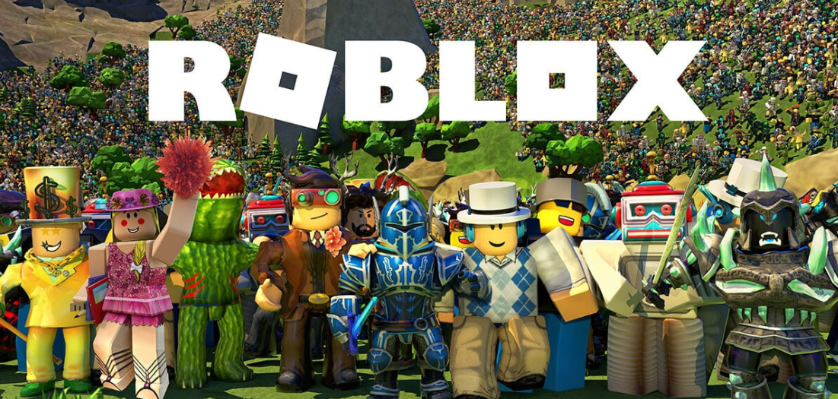
Example 5.2. Roblox
Online gaming platform for kids and teens
Students can create adventures, play games, role play, and learn with their friends in a family-friendly, immersive, 3D environment
https://www.roblox.com

Slide 30
Exploring games
Group activity

Slide 31
Exploring games
Each group should choose one of the presented websites or games, explore it in more detail, and discuss its possible integration in the classroom.
Share your ideas with the teacher and the other groups.

Slide 32
Questions

