Slide 1
Workshop 1: Game Based Learning (GBL) and unplugged activities
Session 2: GBL with unplugged activities

Slide 2
Authors and licence
Authors:
Daniela Tuparova, South-West University „Neofit Rilski”, Faculty of Mathematics and Natural Sciences ddureva@abv.bg
Ivanichka Nestorova, South-West University „Neofit Rilski”, Faculty of Mathematics and Natural Sciences iva.nestorova@gmail.com
This work is licensed under a Creative Commons Attribution-ShareAlike 4.0 International License.
Attribution should be given in the following way: GLAT project, https://ec.europa.eu/programmes/erasmus-plus/projects/eplus-project-details/#project/2017-1-HR01-KA201-035362

Slide 3
Agenda
Introduction to unplugged activities
Types of unplugged activities
Examples related to specific school subjects

Slide 4
Unplugged activities
Activities that enable teaching and learning without using computers
Teaching through engaging games and puzzles that use worksheets, cards, strings, crayons,…
suitable for development of computational and algorithmic thinking
can be used in different part of the lesson and for different content
suitable for collaborative and individual work

Slide 5
Types of unplugged activities

Slide 6
Types of unplugged activities
1. Finding words in the grid
2. Real-life algorithms
3. Algorithms and analogies for concepts related to specific school subjects
4. Moving through a maze
5. Tales and Algorithms
6. Writing or drawing in grid

Slide 7
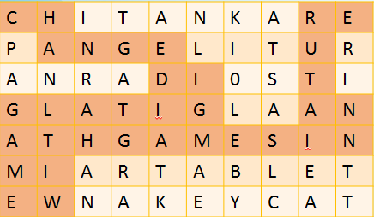
1. Finding words in the grid
Finding words or sentences
Following instructions to find the hidden word from the given starting point
There is a hidden rule about the use of digital games in this grid. Can you find it?

Slide 8
Analysing examples
Group activity

Slide 9
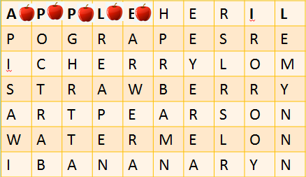
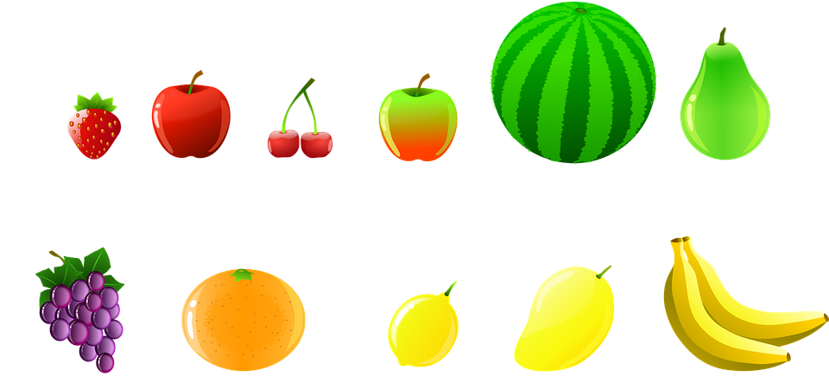
Example 1: Hidden fruits (English, Math)
Find the hidden fruits in the grid and put the picture of relevant fruit near the alphabet signs of it name.
How many pictures of the fruits do you need for each word?

Slide 10
Example 2: Numbers (Math, Computer science)
Task for students:
1. Find the two digit numbers with equal digit.
2. Order them in ascending order.
3. Replace the numbers with relevant alphabet sign.
4. Which word do you obtain?
5. Explain how to use it?
34-m | 11-P | 43-n | 25-F | 12-b | 31-G
43-n | 22-a | 33-s | 33-s | 13-c | 12-b
21-l | 12-b | 21-l | 44-W | 13-c | 13-c
23-E | 13-c | 23-E | 55-o | 66-r | 77-d
13-c | 25-F | 43-n | 23-E | 13-c | 25-F

Slide 11
Example 3: Word search (English, Computer science)
Follow given instructions to find the hidden word. Start from upper left corner.
What is the meaning of the word?
P | a | a | o | p | y
C | S | S | c | a | d
o | M | W | O | T | e
U | p | U | R | D | i
m | n | t | e | r | M
Go right
Go down
Go right
Go down
Go right
Go down
Go right

Slide 12
Idea for activity
Divide the class in two groups and organize contest
first group has to hide words in the grids and describe with arrows how to find the words
second group has to follow the algorithm for moving and to find the words and explain it
Time for word finding could be set
Badges for founded word could be awarded

Slide 13
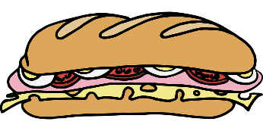
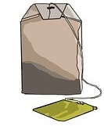
2. Real life algorithms
Recognizing algorithms in our daily lives:
making sandwich
preparing tea
cleaning teeth
preparing school backpack
natural phenomenon

Slide 14
Analysing examples
Group activity

Slide 15
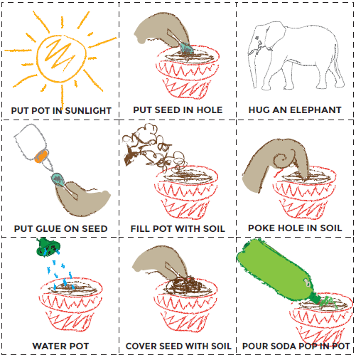
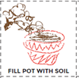
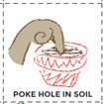
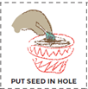
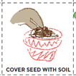
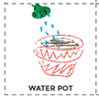
Example 1: Code.org – Plant a seed
Students create an algorithm to help each other plant a seed
They cut out the steps for planting a seed from the provided worksheet and work together to choose the six correct steps from nine options
https://studio.code.org/s/course1/stage/6/puzzle/1

Slide 16
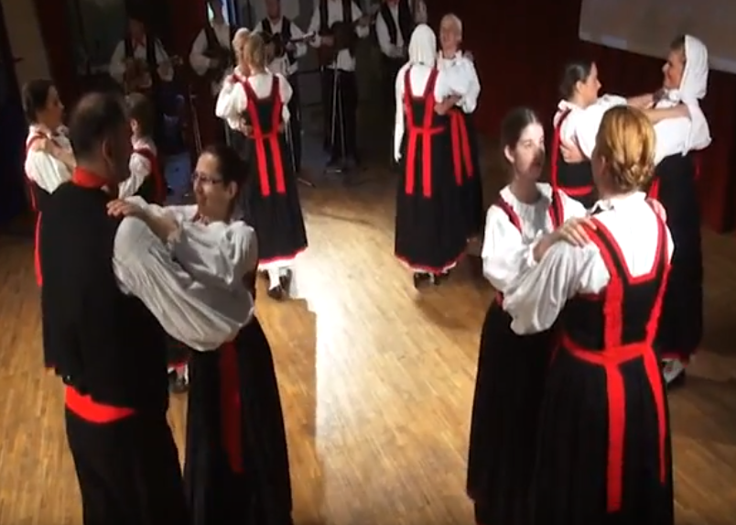
Example 2: Dance moves
Students recognize dance structures
They label the entire dance performance with the agreed marks
They connect dance structures with the corresponding part of the music background
https://www.youtube.com/watch?v=PPNbH1shbJI

Slide 17
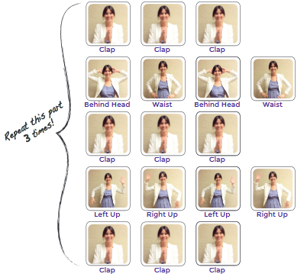
Example 3: Code.org - Getting Loopy
Students are introduced to the programming concept of loops (repeated instructions) through a dance activity (simple choreography).
https://studio.code.org/s/course1/ stage/12/puzzle/1

Slide 18
Idea for activity
Make photos with different statement of the hands or legs
Introduce the concept loop
Tasks for students:
to arrange dance or gymnastic exercise
to perform dance or gymnastic exercise according to given algorithm

Slide 19
3. Algorithms and analogies for concepts related to specific school subjects
Ordering of rules
preforming mathematical operations
grammar
Writing a song as algorithm (set od instructions)
1.
2.
3.

Slide 20
Analysing examples
Group activity

Slide 21
Example 1: Adding numbers (Math)
Ordering of steps (rule) to add two three-digit numbers
Steps are written on the paper and cut
students have to order steps
or the steps are given in wrong order and students have to find error in the algorithm
253
+471

Slide 22
Example 2: Present Simple vs. Present Continuous (English)
General present
Permanent activity
Unlimited duration
Immediate present
Temporary
activity
Limited duration
Rule for determining the appropriate tense
I like tea.
Keep quiet! The baby is sleeping.

Slide 23
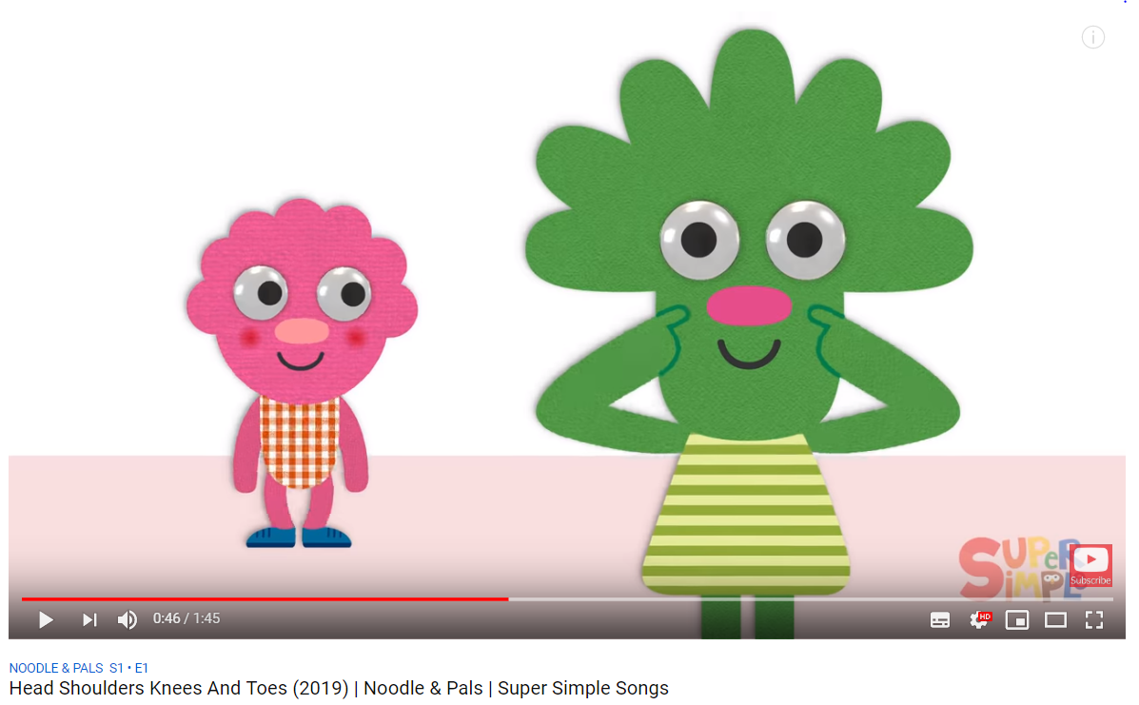
Example 3: Loops in the song (Music)
Students should find part in song that have to be repeated
https://www.youtube.com/watch?v=RuqvGiZi0qg

Slide 24
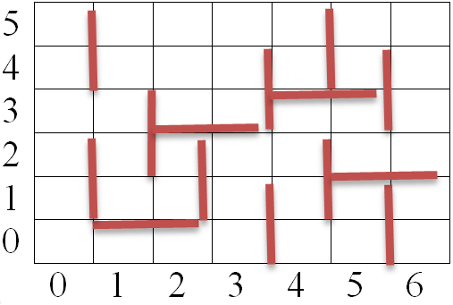
4. Moving through a maze
Moving characters through a maze using arrows
Plan a route from the start location
Use arrows to describe path

Slide 25
Analysing examples
Group activity

Slide 26
Example 1: Code.org - Happy maps
Students create simple algorithms to move a character through a maze
https://studio.code.org/s/course1/stage/1/puzzle/1

Slide 27
Example 2: Describing path
Students use arrows to describe path between robots.

Slide 28
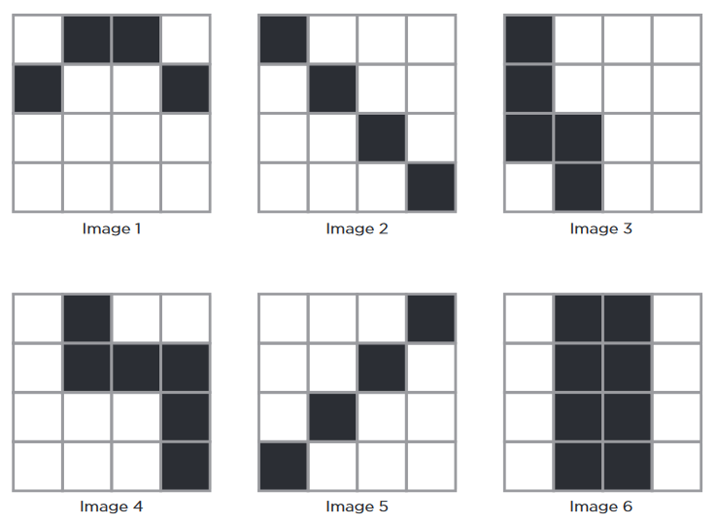
Example 3: Code.org - Graph Paper Programming
Students write an algorithm using a set of predefined commands to direct their classmates to reproduce a drawing (to color squares in on graph paper)
https://studio.code.org/s/course2/stage/1/puzzle/1

Slide 29
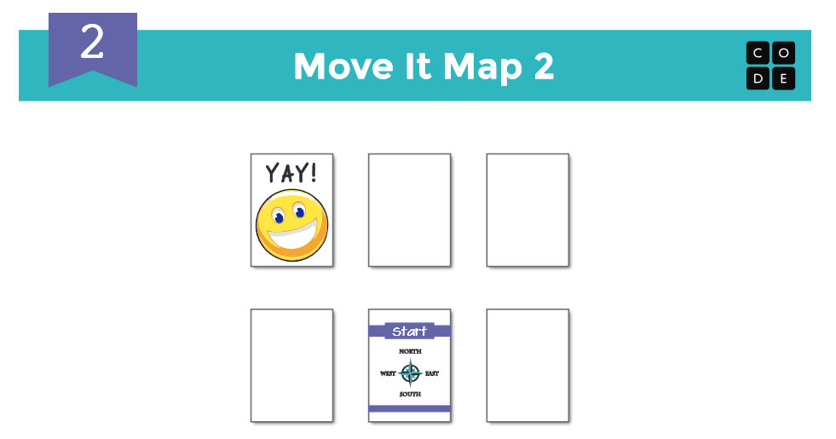
Example 4: Code.org - Move it
Students learn how to think ahead in multiple steps, as they plan a short route from the start location to the hidden smiley face, up to three steps away
Starting point is the piece of paper imprinted with the compass rose
https://studio.code.org/s/course1/stage/2/puzzle/1

Slide 30
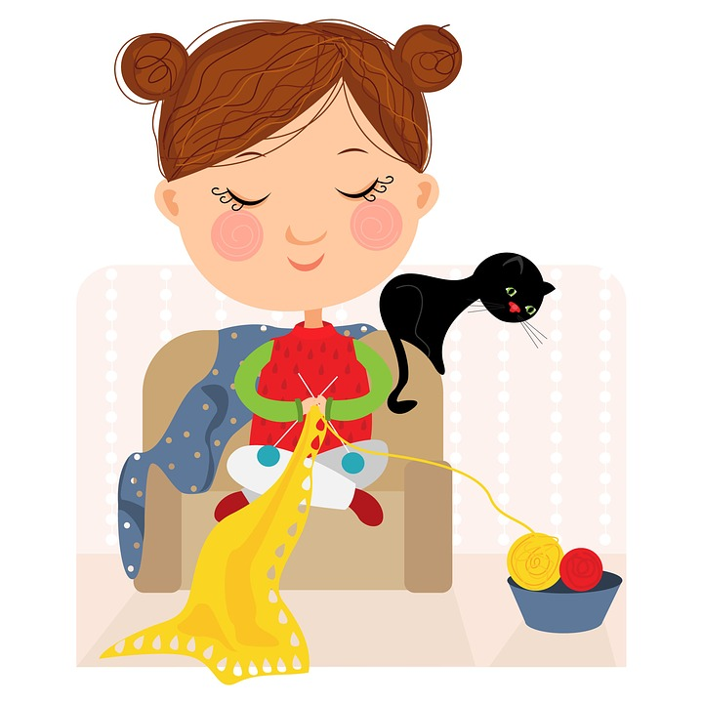
5. Tales and algorithms
Recognizing algorithms in familiar stories and fairy tales:
The Wild Swans tale by Hans Christian Andersen → Elisa knits shirts for her eleven brothers
Hansel and Gretel → they execute an algorithm to get home from the forest
Cinderella → looking for a girl who will fit the shoe

Slide 31
Analysing examples
Group activity

Slide 32
Example: Cinderella
Find Cinderella
1. Find a girl
2. Try the shoe
3. If the shoe fits, then Cinderella is found, in other case go to step 1

Slide 33
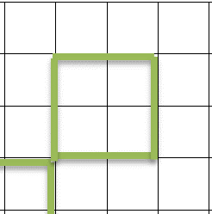
6. Writing or drawing in a grid
Using a sequence of signs to:
write numbers or words
draw shapes

Slide 34
Analysing examples
Group activity

Slide 35
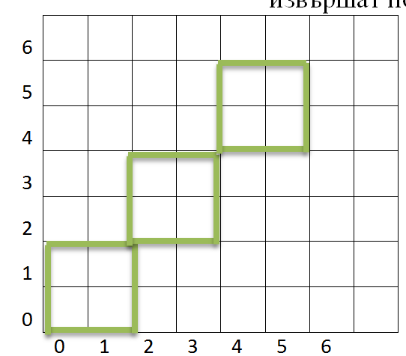
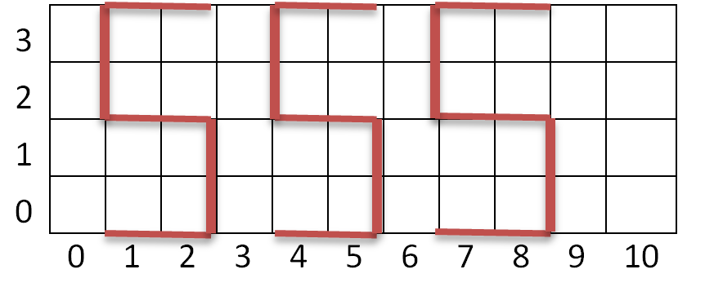
Example: Writing letters and drawing shapes
Students use the following signs to write numbers or words
move:
draw:
do not draw:

Slide 36
Discussing examples
Group activity

Slide 37
Discussing examples
Discuss in groups possible variants for modification of the presented examples and give similar examples for different subjects in primary school.
Share your ideas with other groups.
1. Find of words in the grid
2. Real-life algorithms
3. Algorithms and analogies for concepts related to specific school subjects
4. Moving through a maze
5. Tales and algorithms
6. Writing or drawing in grid

Slide 38
Questions

