Slide 1
Workshop 1: Game Based Learning (GBL) and unplugged activities
Session 1: Game Based Learning (GBL)
Games in education

Slide 2
Authors and licence
Authors:
Jože Rugelj, University of Ljubljana, Faculty of Education Joze.Rugelj@pef.uni-lj.si
Mateja Bevčič, University of Ljubljana, Faculty of Education Mateja.Bevcic@pef.uni-lj.si
Anja Luštek, University of Ljubljana, Faculty of Education Anja.Lustek@pef.uni-lj.si
This work is licensed under a Creative Commons Attribution-ShareAlike 4.0 International License.
Attribution should be given in the following way: GLAT project, https://ec.europa.eu/programmes/erasmus-plus/projects/eplus-project-details/#project/2017-1-HR01-KA201-035362

Slide 3
Agenda
Games in child development
Educational games
Educational games in the learning process

Slide 4
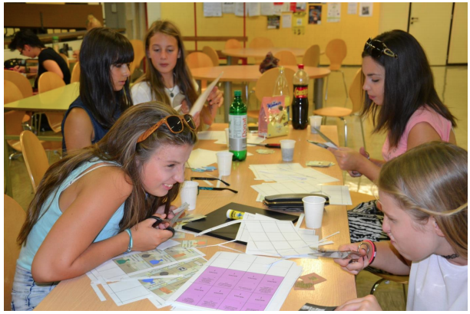
Introduction
Characteristics of efficient approaches to learning:
student-centered
active
problem-based
directed to higher-order educational goals
motivational
supported by ICT
Educational games can integrate most of these characteristics!

Slide 5
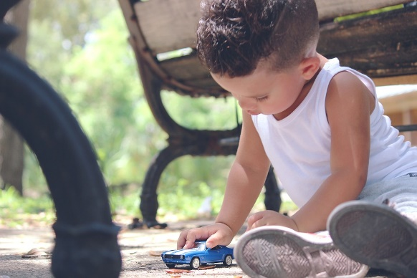
Influence of games on child development
Importance of child’s play on the development of emotional, social, physical and cognitive growth
Play is one of the most important activities for the development of important skills for life, regardless of age or level of development:
quick adoption to new circumstances
handling change with ease
During play, the child discovers basic concepts from the real world and the first fundamental relationships between them are created

Slide 6
Games in human development
Vygotsky (1896 - 1934): “Play contains in a concentrated form all developmental tendencies - the most significant psychological achievements of the early childhood occur while children engage in play.”
Jean Piaget (1896 – 1980):
“Play is the incorporation of new intellectual material into the already existing cognitive structures, without a corresponding alteration of the structures themselves.”
“Play is the consolidation of newly learned behaviour. Repetition of learned concepts makes them an established part of the mental repertoire.”
Jerome Bruner (1915 – 2016): “Play provides a comfortable and relaxed atmosphere in which children can learn to solve a variety of problems, making them able to efficiently cope with complex problems of the real world.”

Slide 7
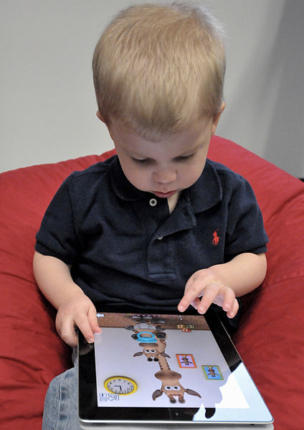
Specific characteristics of Digital Generation learners (Prensky, 2001)
Technology usage fluency
Multi-tasking
Individualization and personalization
Increased connectedness
Immediacy
Multiple media types
Engagement and working attitude
Sociality and team spirit
https://commons.wikimedia.org/wiki/File:Child_with_Apple_iPad.jpg

Slide 8
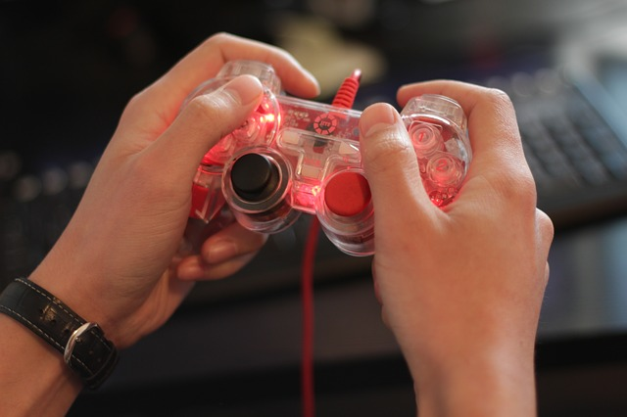
Additional characteristics of “gamers”
Ability to follow instructions
Possession of problem-solving strategies
Quick thinking
Random access to resources
Increased hand-eye coordination and fine motor skills
Spatial reasoning
Stimulating learning experience

Slide 9
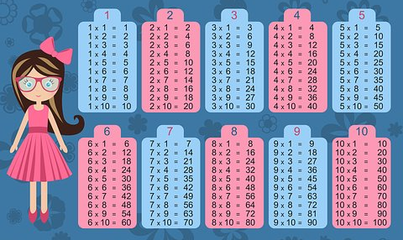
Games and learning theories 1/2
Behaviourism
one correct answer, immediate response
positive response (happy sound, positive character reaction that stimulate positive emotions)
games that have a drill and practice concept build in (e.g. multiplication table)
Constructivsm
learning is an active process of constructing knowledge, built recursively on knowledge that the user already has
game environment where the students can construct their own knowledge

Slide 10
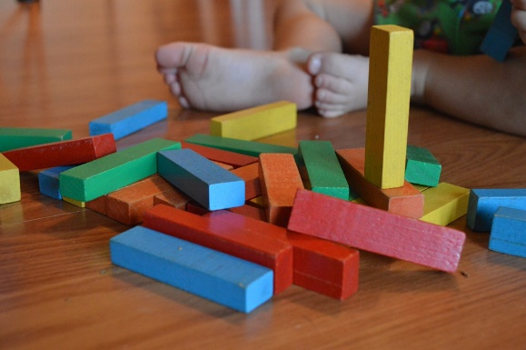
Games and learning theories 2/2
Constructivism
own representation of knowledge
learning occurs when the learners’ exploration uncovers an inconsistency between their current knowledge representation and their experience
learning takes place within a social context and interaction between learners and their peers is a necessary part of the learning process
Teacher‘s task: guiding and providing feedback
Examples: role-playing, adventures, detective games, strategies,...

Slide 11
Educational games

Slide 12
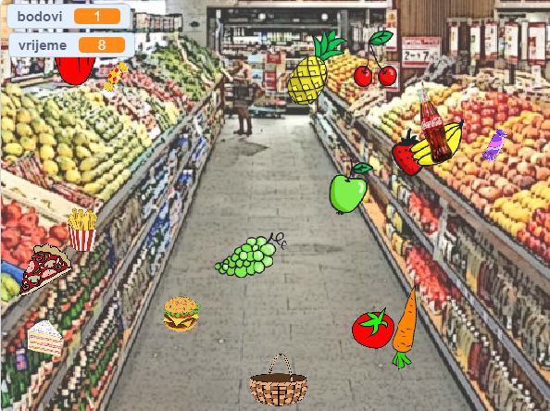
Educational games
What makes a computer game educational (serious)?
Well-defined learning goals (blurred in the game)
promotion of development of strategies and skills of learners
Elements contributing to educational values of games:
sensual stimuli
fantasy
challenge
curiosity
But even serious games have to be funny!

Slide 13
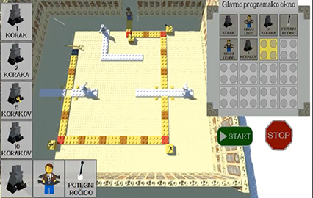
Eductional game elements
Educational games must include:
compelling storyline
challenge (i.e., a problem to be solved)
rules of engagement
interaction within the environment and control
continuous feedback
particular goals or outcomes to achieve
The task must not be perceived as so difficult that there is no chance of success

Slide 14
Educational games in the learning process
Scaffolding needed to support students' perception that the challenge is achievable
different levels of mastery for students in the class (individualization)
Student responses used to structure learning
Timely corrective and progress-acknowledging feedback
correct mistakes
build understanding progressively
recognize incremental progress

Slide 15
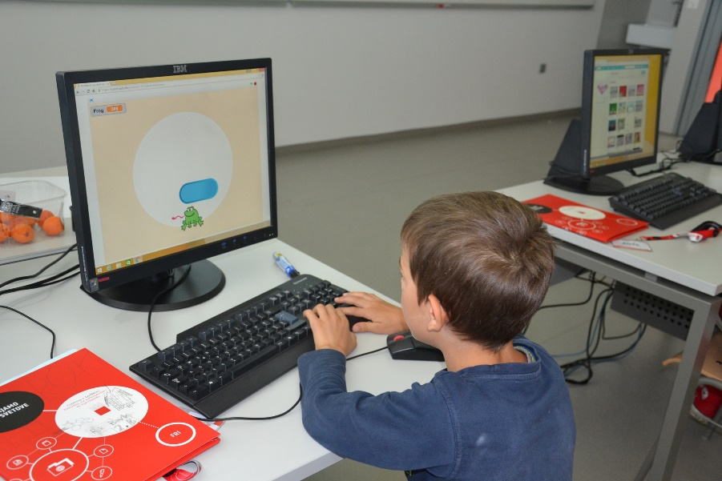
Methodologies for using games for learning
Suggested methodologies:
games as a motivation before the lecture
teacher playing a game during the lecture
game as a group activity in the classroom
game as a home activity/independent learning
Important: Use educational games only when they increase the effectiveness of learning.

Slide 16
Implementation of games into the learning process
phase - Identification and evaluation of suitable games
phase - Integration of games
very often playing games is a time-consuming process - limited time for use of alternative learning resources in formal education

Slide 17
“Learning package”
Consisting of briefing, post-game discussion, and reflection
The teacher has to prepare the “learning package” taking into account:
students’ background and previous knowledge
learning goals
curriculum
technical resources
her own competences
Each implementation has to be evaluated by the teacher to determine to what extent learning goals have been achieved

Slide 18
Exploring existing games
Individual activity

Slide 19
Exploring existing games
Explore some of the following games and think whether they are suitable for inclusion in the learning process:
http://hrast.pef.uni-lj.si/games
https://www.tynker.com/
http://lightbot.com/flash.html
https://code.org/
https://codecombat.com/play
https://home.jeita.or.jp/is/highschool/algo/index_en.html
https://blockly-games.appspot.com/

Slide 20
Preparing “learning package”
Group activity

Slide 21
Preparing „learning package”
Each group should choose one of the following games, prepare a “learning package“ and present it to the other groups
Reality Show Restaurant (SL, EN)
http://hrast.pef.uni-lj.si/games/website/restavracija.html
Luke saviour (SL, EN)
http://hrast.pef.uni-lj.si/games/website/LukecResitelj.html
Light Bot (HR, SL, EN)
http://lightbot.com/flash.html

Slide 22
Questions to help prepare a “learning package”
To whom is the game intended?
How will the game be included in the classroom (introduction to the new material, during the class, repetition, tasks, ...)?
Are there any instructions? How will they be delivered to students?
What role will the teacher have?
Is additional material needed (worksheets, ...)?
What activities will be conducted before and after playing the game?
How will the game analysis (reflection) be performed?

Slide 23
Questions

