Slide 1
Workshop 1: Game Based Learning (GBL) and unplugged activities
Session 4: Designing learning scenarios

Slide 2
Authors and licence
Author:
Jasminka Mezak, University of Rijeka, Faculty of Teacher Education jasminka.mezak@ufri.uniri.hr
This work is licensed under a Creative Commons Attribution-ShareAlike 4.0 International License.
Attribution should be given in the following way: GLAT project,https://ec.europa.eu/programmes/erasmus-plus/projects/eplus-project-details/#project/2017-1-HR01-KA201-035362

Slide 3
Agenda
Introduction
Learning scenarios with examples
Examples of learning scenarios for selected activities
Practical work - Creating learning scenarios

Slide 4
Educational process
Preparation
Implementation
Evaluation
Contemporary approach, applying the appropriate strategies, methods and teaching techniques

Slide 5
Teacher competences
Teaching skills for planning, preparation, performance and teaching lesson
Include active learning:
understanding
expressing own attitude
critical thinking
creative problem solving
Skills for monitoring and evaluating students

Slide 6
Planning and preparation
Designing the learning environment:
one task
several tasks
learning unit
the entire teaching subject
Defining:
resource and learning materials
equipment (technology)
activities

Slide 7
Learning scenarios
Documents that contain innovative and creative ideas for teaching activities using contemporary teaching methods with the use of appropriate digital content and tools
Textual or graphical form (LePlanner)
Included in the teaching process as a whole teaching unit or as a part of the teaching unit

Slide 8
Elements of Learning scenario
The main elements that the scenario should contain:
Description of activities
The learning outcomes that will be realized with specified activities
Methods and forms of teaching
Tools for realizing the learning outcomes

Slide 9
Analysing examples
Group activity

Slide 10
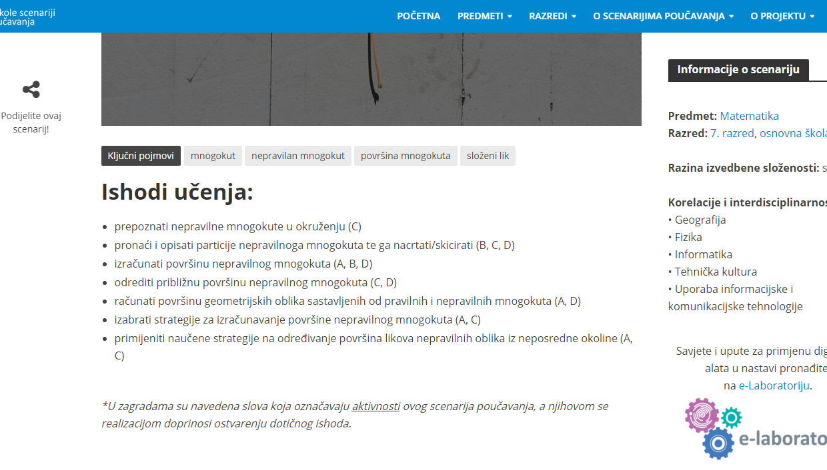
Example 1: CARNet project „e-škole”
https://scenariji-poucavanja.e-skole.hr/

Slide 11
Example 2: Code.org – Plant a seed
https://code.org/curriculum/course1/6/Teacher

Slide 12
Example 3: Colaborative Education Lab
http://colab.eun.org/learning-scenarios
Notes:
The document with the template (GLAT_Learning_scenario_template_EN.docx) should be in the same folder as this presentation.

Slide 13
Example 4: LePlanner
https://leplanner.net/#/

Slide 14
Example of a GLAT learning scenario

Slide 15
Example: Moving through the maze/Spatial orientation 1/5
Learning Scenario Title | Moving through the maze/Spatial orientation
Course / Grade | Science, 1st grade
Learning Outcomes | General learning outcomes Determine the direction of movement: left-right, up-down and back and forth Moving in different directions in space (left-right, back and forth) Suggest the steps to navigate by the given path Suggest the steps to move from the starting to the ending position Specific LO oriented on algorithmic thinking Interpret the term algorithm Determine a set to reach a predetermined goal
Aim, Tasks and Short Description of Activities | As part of the Science lesson, for repetition and practicing the concepts left and right, up and down and back and forth, the students will solve the worksheet with maze by placing the arrows to determine the default path. Students will lead each other from the initial position to the final position in the classroom. ----------- Students will get familiar with the term algorithm as a sequence of commands needed to accomplish the goal - arriving at the default location.

Slide 16
Example: Moving through the maze/Spatial orientation 2/5
Keywords | Left-right, up-down, back-forth, algorithm, command
Correlation and Interdisciplinarity | Science, Physical Education and Informatics
Duration of Activities | 45 minutes
Teaching Methods | Game-Based Learning Dialog method Problem-solving method
Teaching Forms | Frontal teaching Individual work Group work by four students
Tools | none

Slide 17
Example: Moving through the maze/Spatial orientation 3/5
Resources/materials for the Teacher | Tools Canva and Microsoft Word for creating worksheets
Resources/Materials for the Students | Worksheet Scissors Pencil and notebook
Teaching summary | Motivation – introduction to activity The teacher can stand next to the door of the classroom and ask the students for help to get to the blackboard. Students direct the teacher by specifying and counting the steps. The teacher can write his "path" on the blackboard stating the steps (commands) he has made. Other possible ways of getting from the door to the blackboard can be pointed out in the conversation with students, which brings a conclusion that the same task can be solved in several ways. The term ALGORITHM is explained as a series of actions to be made in order to accomplish a particular task. | Duration 10 minutes

Slide 18
Example: Moving through the maze/Spatial orientation 4/5
Teaching summary | Implementation 1st activity: Solving the worksheet (individual work) Students cut out the arrows from the worksheet and paste them into the maze to point out the path that will get a little bear to his mom. The student who first solved the task reads the steps in a way that assumes the role of a little bear and uses the words left-right and back-forth to read the steps. The next student reads the steps in a way that assumes the role of the observer and uses the words left-right and up-down. 2nd activity: Group game (4 students) One student gives commands to another student (left-right and back-forth to pass the default path between desks and chairs. The task of a third student is to write commands as an algorithm with abbreviations L, R, B and F. All pupils of the group are counting the errors for movement and at the same time the fourth student is writing down those errors. All algorithms for passing through the same maze of different groups are presented on the blackboard and discussed in the classroom. | 25 minutes

Slide 19
Example: Moving through the maze/Spatial orientation 5/5
Teaching summary | Reflection (evaluation) Repeat the word algorithm and its meaning. Students cite the example of the simple tasks they perform daily (getting dressed, washing, preparing school bags ...) and devise an algorithm for solving that task. | 10 minutes
Annexes | Worksheet
Examples and game references | Happy cards https://studio.code.org/s/course1/stage/1/puzzle/1 Artmedia mazes https://www.artrea.com.hr/igre/Labirint2.html
Learning scenario “Moving through the maze”
Notes:
The document with the example „Moving through the maze” (GLAT_WS1_S4_LearningScenario_Example1_EN.docx) should be in the same folder as this presentation.

Slide 20
Designing learning scenario
Group activity

Slide 21
Group activity
Each group should create a learning scenario for a chosen example of unplugged activities designed in the previous Session and present it to teacher and other groups
Use a blank template for creating learning scenario
Discuss the learning outcomes that relate to the subject and the learning outcomes relating to algorithmic thinking
Discuss the methods and forms of teaching that you provided
Discuss the development of activities
Learning Scenario Template
Notes:
The document with the template (GLAT_Learning_scenario_template_EN.docx) should be in the same folder as this presentation.

Slide 22
Questions

